Slide 1
CMC Engineering

Slide 2
Agenda
What is the Cloud Migration Center (CMC)?
Who is part of the CMC?
Where does the Engineering role fit in the CMC?
Workload Migration Process
Engineering Training Outline

Slide 3
What is the Cloud Migration Center (CMC)?

Slide 4
What is the Cloud Migration Center?
Provide an efficient and capable team to migrate workloads and resources to Azure while saving the client time and money by utilizing tested and practiced processes
Provides project planning and execution all in a service center mentality to drive down cost how?
Scales with the flow of a migration so a client is paying for utilization
Uses standard cookie cutter process for scalability and reliability
Is the SME and trusted adviser for IaaS migration

Slide 5
Who is part of the Cloud Migration Center (CMC)

Slide 6
Who is part of the Cloud Migration Center?
The CMC Team is divided into PODs. Each PODs consist of the following CMC roles:
CMC Team Lead
CMC Engineer
Technical Onboarding Manager

Slide 7
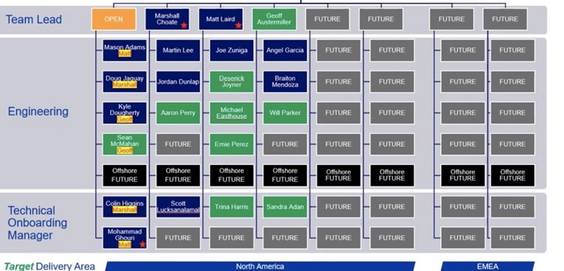
Who is part of the Cloud Migration Center?

Slide 8
Who is part of the Cloud Migration Center?
The CMC Team consist of the following Roles:
CMC Team lead CMC Leads handle reviewing the SOW, the deliverables, and the execution plan of the project. They are also an escalation point on the project and handle forecasting with the DD/DM of CMC resources.
CMC Engineer CMC Engineer's handle the execution of the migration to the Azure Environment. They will work hand in hand with the DM/DD, Project Architect and the TOMs which also includes post support for the client for an agreed amount of time weeks after migration.
Technical Onboarding Managers (TOMs) TOMs work closely with the client on gathering server requirements and ensure data integrity to ensure a clean landing of resources into Azure.

Slide 9
Who does the Cloud Migration Center work with?
The CMC Team typically works with the following Roles:
Architect / Tech Lead Architects are staffed on CMC projects to provide technical expertise, they assist with workloads that might need more in-depth discovery, or may not be eligible for lift and shift and will need a "snow flake" approach to migration into a technology that is Azure or cloud native.
Delivery Director/Delivery Manager Organize all parties associated with the project. They maintain milestones and objectives associated with , burn vs earn, project forecasting, and ensure all partiers are delivering on their objectives.
Clients Who we are empowering, they typically provide a core team of stake holders that are there to assist with knowledge and understanding that is intrinsic to working and maintaining systems for their lifetimes.

Slide 10
Where does the Engineer role fit?

Slide 11
Where does the Engineer role fit?
The Engineer role is the execution of the project planning, this includes replicating, testing, and migrating servers and the deployment of LZ's.
Utilizing the information that comes from the discovery session's the TOM's have and the migration plan developed by the app team and the CMC to facilitate server migration.
Ensuring the project is on track from a technical standpoint.
Attending weekly or daily meetings to review requirements and ensure that the migration is fully prepped.
Maintain ADO board to keep migrations organized and up to date.

Slide 12
Workload Migration Process

Slide 13
Workload Migration Process
Landing Zone
Pilot
Discover
Migrate
Manage,
Optimize, Secure
Evaluate current landing zone, or prepare the landing zone
Provide recommendations on any findings
Remediate where needed
Migration Tooling Setup (ASR)
Migrate pilot server group or workload
Learn your environment
Establish build processes
Fine-tune processes
Begin Discovery
Prioritize migration workloads and align to phases
Workload analysis and architecture deep dive
Assess workload for cloud readiness
Identify migration strategy for each workload
Adjust initial migration plan, if needed
Schedule migration with the CMC
Replicate the workloads to the target Azure regions
Perform failover testing
Cutover the workloads to the target Azure regions
Perform post-failover setup for the workload and handoff to 10th Magnitude’s Managed Services
Managed operations
Optimize migrated workloads
Secure migrated workloads
MBG Managed Services
This portion is handled by the Tech Lead / Project Architect and Delivery Manager
Technical Onboarding Manager
CMC Engineer Team

Slide 14
Sample Migration Cycle
Continuous Discovery and Migration
Week 1
Week 2
Week 3
Week 4
Week 5+
Discovery
Meet with workload owners and stakeholders to gather information, dependencies, timeline and build a plan for migrating the workload or workload group.
Migration Group 1 - Pilot
Identify a low impact workload for tooling and process testing
Conduct a migration to demonstrate and fine tune tooling, process, plans
Start discovery for the next migration group
Migration Groups 2+
The 10M Migration Center will replicate and perform cutover on groups of workloads
Perform testing to verify the workload meets customer standards
Transition
Transition the workload to 10M Managed Services
Provide documentation
Repeat
Cycle through the process to quickly migrate groups of servers and workloads
Migration Leadership Team Sprint - 2 Weeks
Ongoing Work
Migration Leadership Team
Landing Zone Assessment and Preparation
Group 1 - Pilot Discovery
Group 2 Discovery
Group 3 Discovery
Group n
Discovery
Group 1 - Pilot Migration
Group 2 Migration
Group n
Migration
Migration Center
Sprint - 1 Week
Cloud Migration Center
Managed Services

Slide 15
Client’s Environment

Slide 16
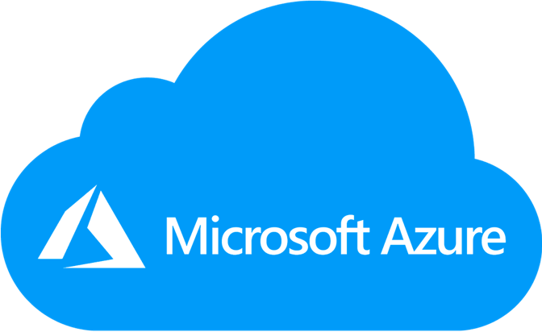

Client’s Environment ( High Level) Example *This is an example scenario. Not all client have the same environment
Azure Cloud
Client’s On Prem Server or Datacenter
Network/Virtual Network/Firewall
Network/Virtual Network/Firewall
Migrate
Server
Server
Server
Server
Server
Server
Server
Server
DB
DB
DB
DB
DB
DB
DB
DB
Apps
Apps
Apps
Apps
Apps
Apps
Apps
Apps
Apps
Apps
Apps
Apps
Apps
Apps
Apps
Apps
Apps
Apps
Apps
Apps
Apps
Apps
Apps
Apps
Migrate
Apps
Apps
Apps
Apps
Apps
Apps
Apps
Apps
Apps
Apps
Apps
Apps
Apps
Apps
Apps
Apps
Apps
Apps
Apps
Apps
Apps
Apps
Apps
Apps
Apps
Apps
Apps
Apps
Apps
Apps
Apps
Apps
Apps
Apps
Apps
Apps
Apps
Apps
Apps
Apps
External Users accessing the app (client’s customers)
Benefits of the Azure Cloud
Client’s Customer
Client’s Customer
Client’s Customer
Client’s Customer
Client’s Customer
Client’s Customer
High Availability
Scalability and Elasticity
Low Latency
Reduce CapEx and move to OpEx
Client’s Customer
Client’s Customer
Client’s Customer
Client’s Customer
Client’s Customer
Client’s Customer
Client’s Customer
Client’s Customer
Client’s Customer
Client’s Customer
Client’s Customer
Client’s Customer
Client’s Customer
Client’s Customer
Client’s Customer
Client’s Customer
Client’s Customer
Client’s Customer

Slide 17
What Is A Landing Zone?

Slide 18
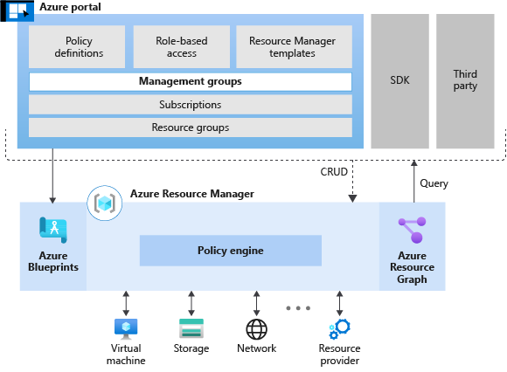
What is a Landing Zone?
Azure landing zones are the output of a multi-subscription Azure environment that accounts for scale, security, governance, networking, and identity. The Azure Landing Zone is basically, in it's simplest form a bunch of services within Azure that give you a place to deploy other Azure services. It is the foundation of the client Azure cloud Environment.

Slide 19
Who Are Managed Services?

Slide 20
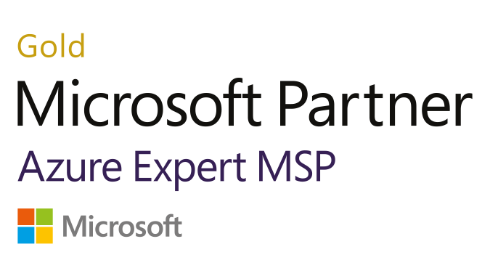



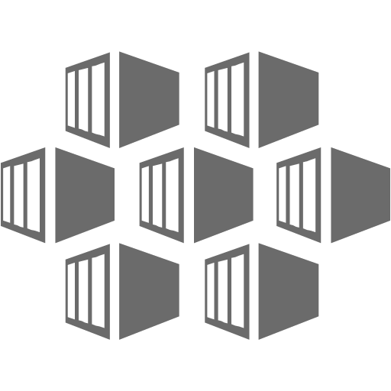




AZURE MANAGED SERVICES
Subject Matter Experts
Business Application Development and Operations
Business Application Management
Cloud EngineeringStandards
Your Teams
10M Architecture, Engineering, and Build
Professional Services
App, Infrastructure, & Network Monitoring
Incident & Problem Management
DevOps Automation
Cost & Perf Optimization
Modern Service Management & ITIL
Patch Management
Backup Management
Unified Security Management
Disaster Recovery
Provisioning Management
24x7 Technical Support
Subscription Management
Azure Cost Management
Governance Management
Managed Services
Customer Portal
Cloud Management Platform
Infrastructure & Services
Microsoft
Azure
IaaS
PaaS
Containers
Data
Network
Storage

Slide 21
Engineers’s Training Schedule

Slide 22
Engineer's Training
Tools:
VS Code - Download PS 7 and setting for terminal - AZ. modules for PS - AZ CLI extension
Terraform
PowerShell if on a Mac
WSL for windows - pick a linux version in the store. https://docs.microsoft.com/en-us/windows/wsl/install-win10
dism.exe /online /enable-feature /featurename:Microsoft-Windows-Subsystem-Linux /all /norestart
https://create.piktochart.com/output/52896398-onboarding-layer-3-cmc

Slide 23

Questions and Answers

